Slide 1
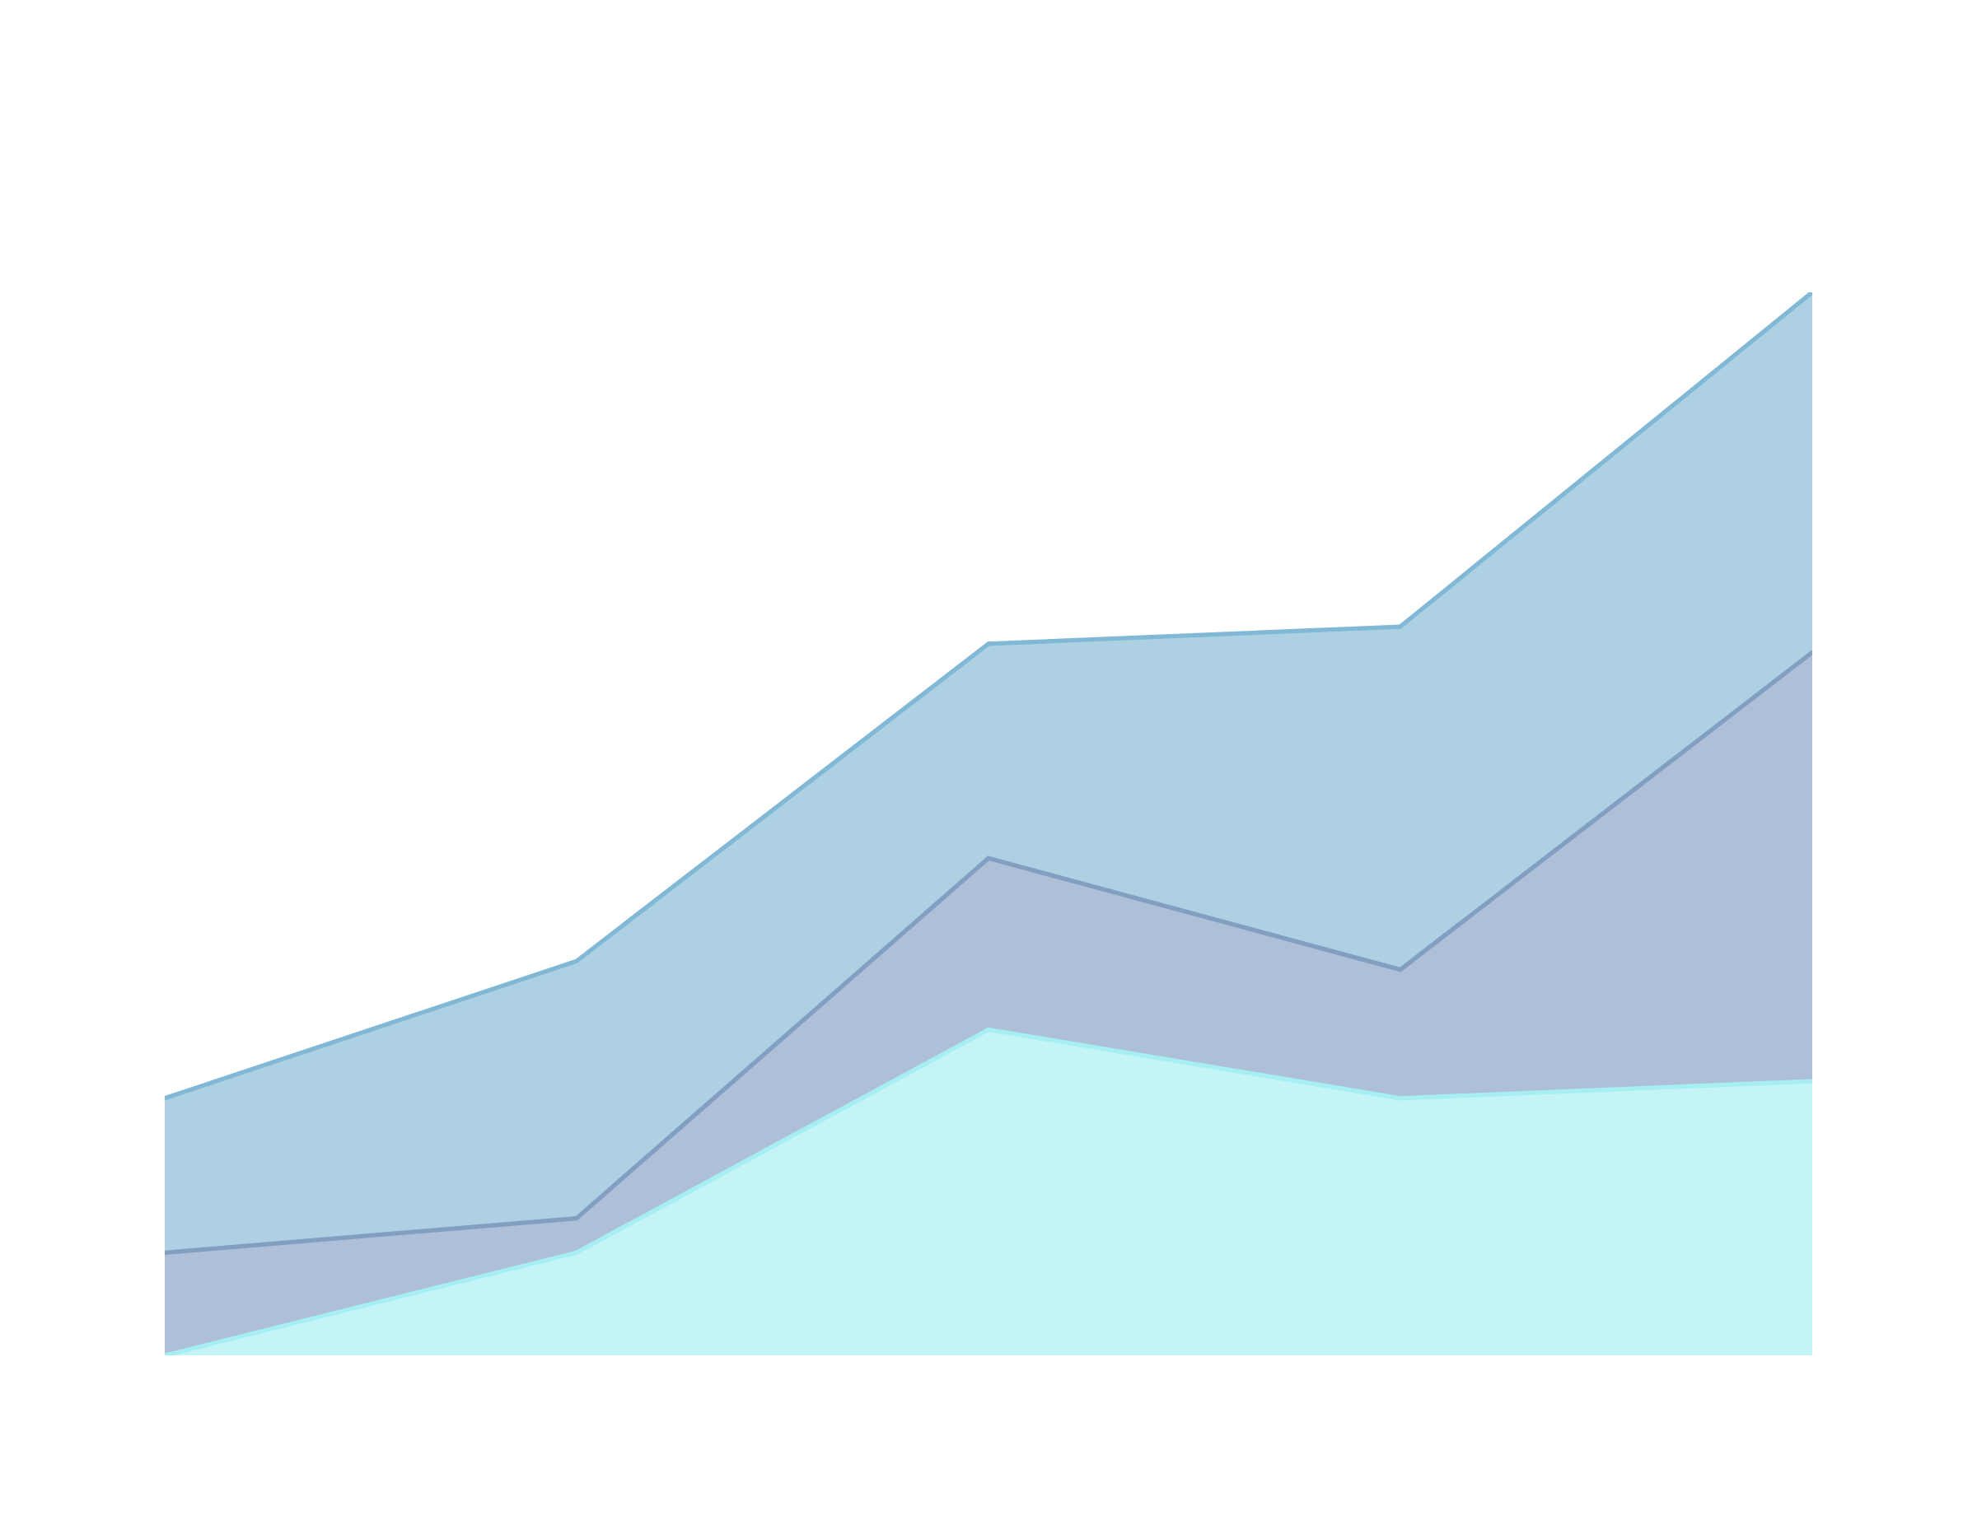
DATA BASE FOR CLEARDATA
PRESENTED BY :
DE CESPEDES MARKO,BLOT ARTHUR, LALINNE ROBIN

Slide 2

SUMMARY
-Context
-MDC
-DATA Dictionary
-Realization of algebraic trees (1 and 2)
-SQL request
-Population of the database
-Improvement proposed.

Slide 3
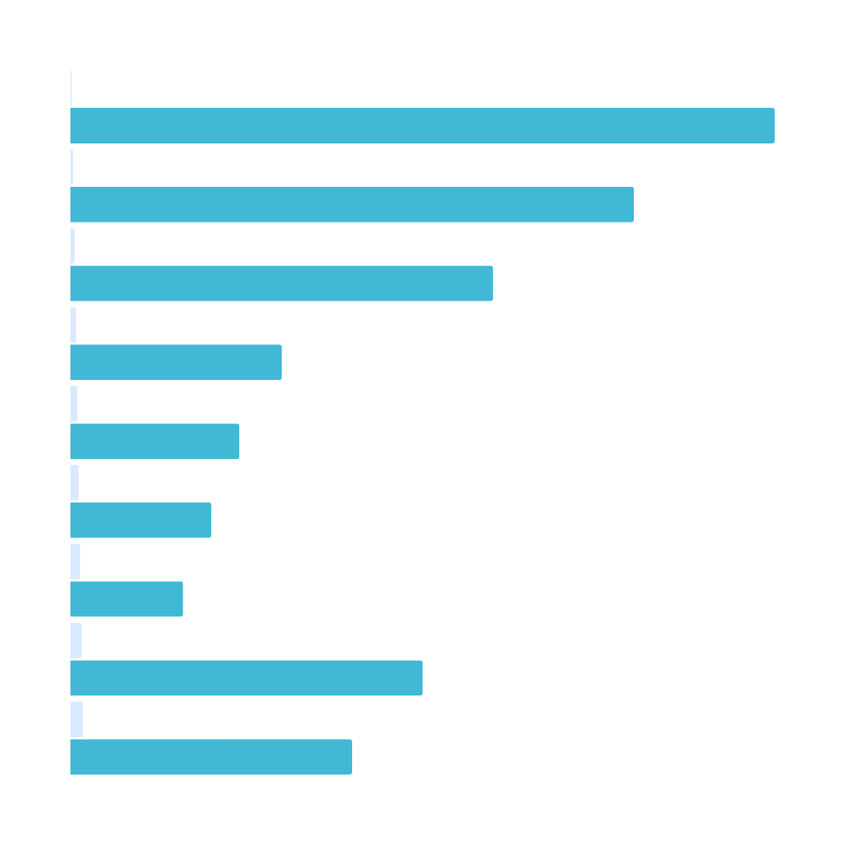
CONTEXT:
The French Ministry and ClearData are creating a centralized SQL database to replace Excel files used by regional agencies to track air quality, staff, and sensors—ensuring better reporting and GDPR compliance.

Slide 4
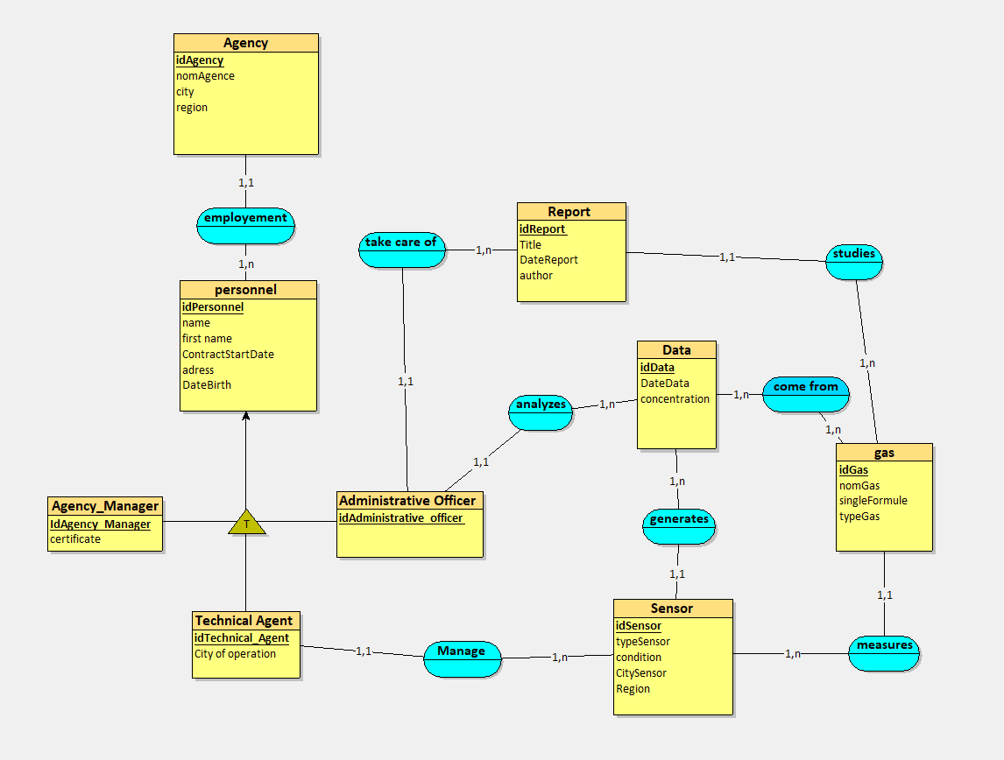
CDM
We have 9 entitys and 8 associations
Use a table when you need to organise detailed numerical or categorical information.

Slide 5
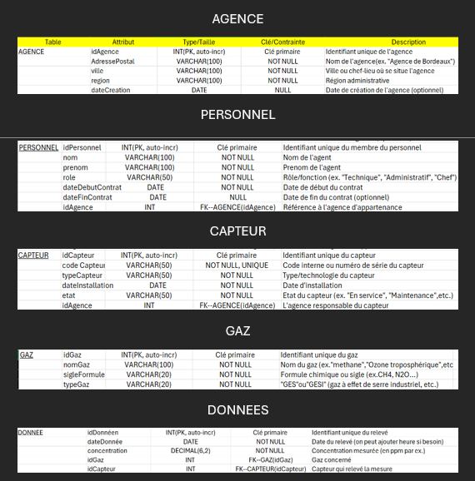
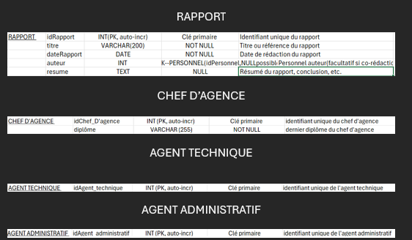
DATA DICTIONARY.

Slide 6
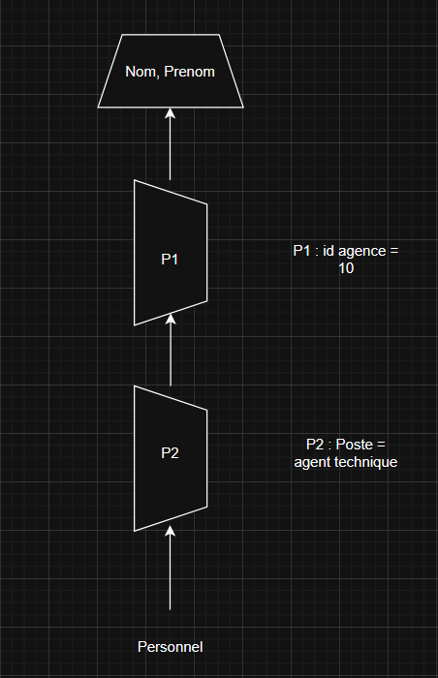
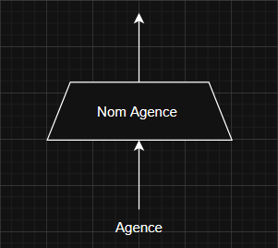
REALIZATION OF ALGEBRAIC TREES.
Number 2
Number 1
We have created the algebraic trees of the queries that you wanted to integrate into your database

Slide 7
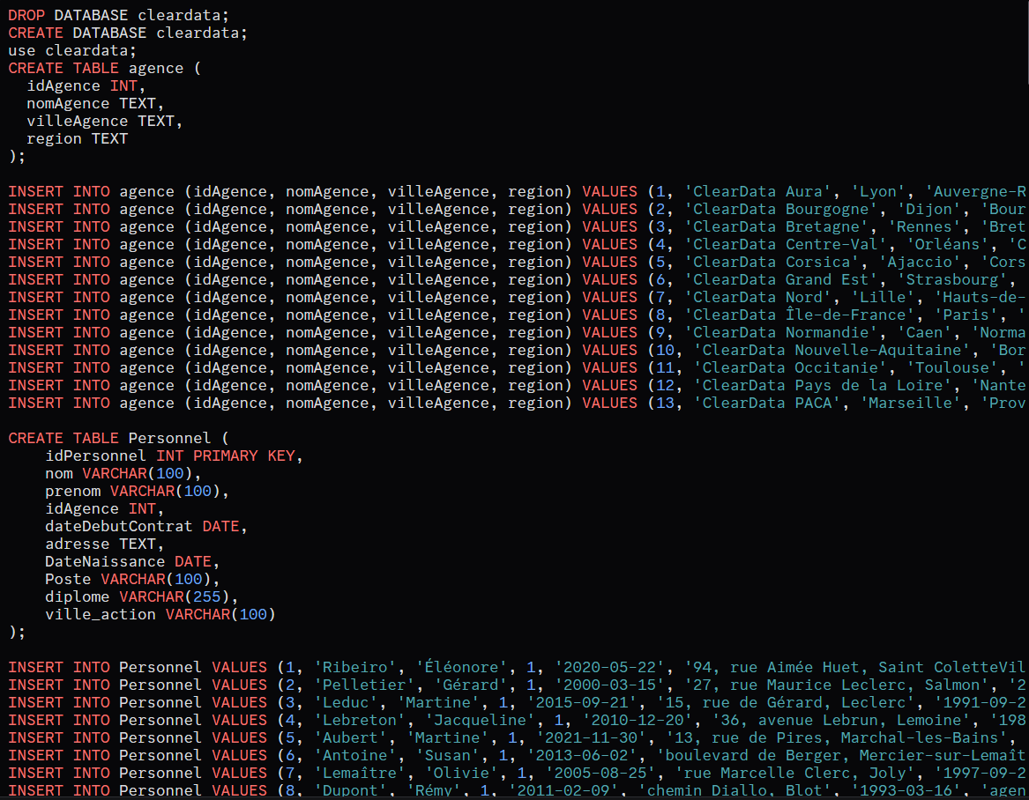
FINAL SQL DATABASE.
We converted the Excel database into SQL to run our queries.

Slide 8

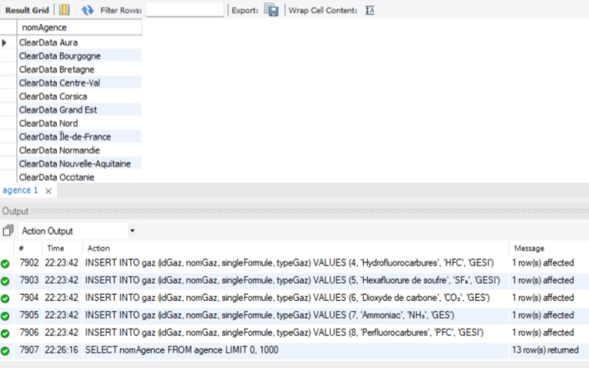
SQL REQUEST
After creating the algebraic trees we made the queries in SQL.
Request 1 :
List of all agencies.

Slide 9
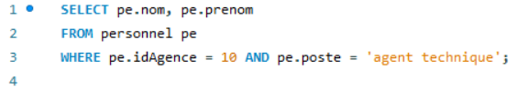
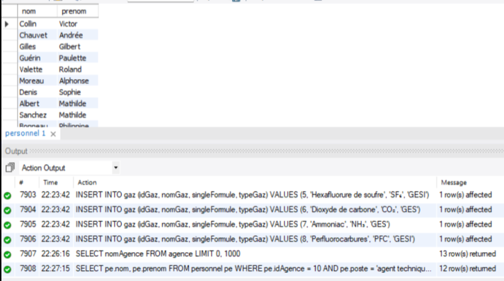
SQL REQUEST
After creating the algebraic trees we made the queries in SQL.
Request 2 : List of all technical
Staff of Bordeaux agency.

Slide 10
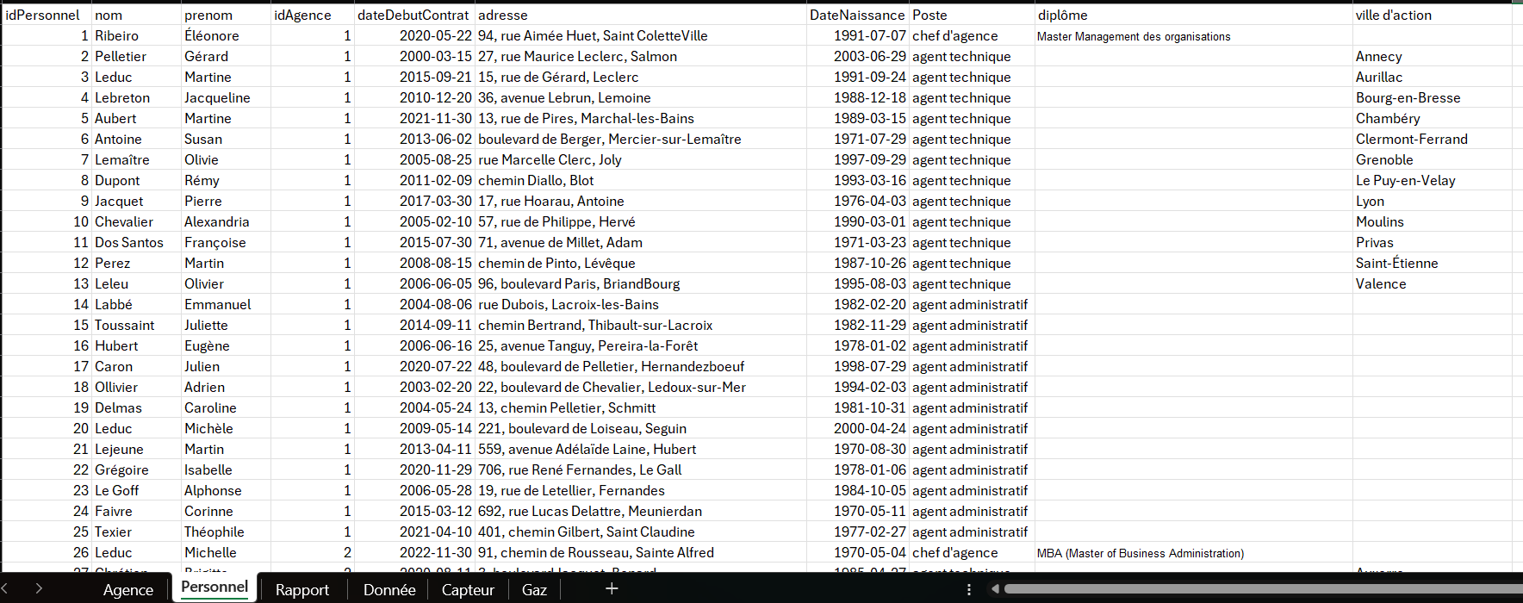
POPULATION OF THE DATABASE
-Data.gouv
-Exemple.xls
-Chatgpt

Slide 11
IMPROVEMENT PROPOSED.
NEW REQUESTS CAN OBVIOUSLY BE ADDED.
DATA ENCRYPTION FOR GREATER SECURITY COULD ALSO SEE THE LIGHT OF DAY.

Slide 12
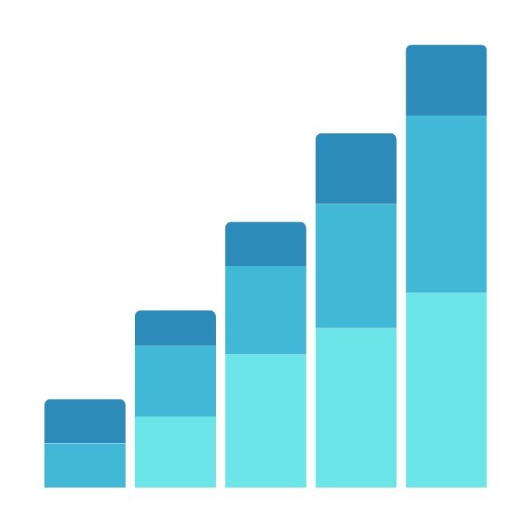
WE THANK YOU FOR LISTENING .
Do you have any questions ?

